Slide 1


Prompt Muons Update - Coincident Events & Systematics Pascal Gutjahr August 15, 2025
WG reviewer: Dennis Soldin
Coll. reviewer: Anatoli Fedynitch
Technical reviewer: Karolin Hymon
Wiki: prompt wiki
Last update: Leadingness Cut
Source: NASA

Slide 2
Coincident Primaries on Final Level
Use dataset 22615

Slide 3
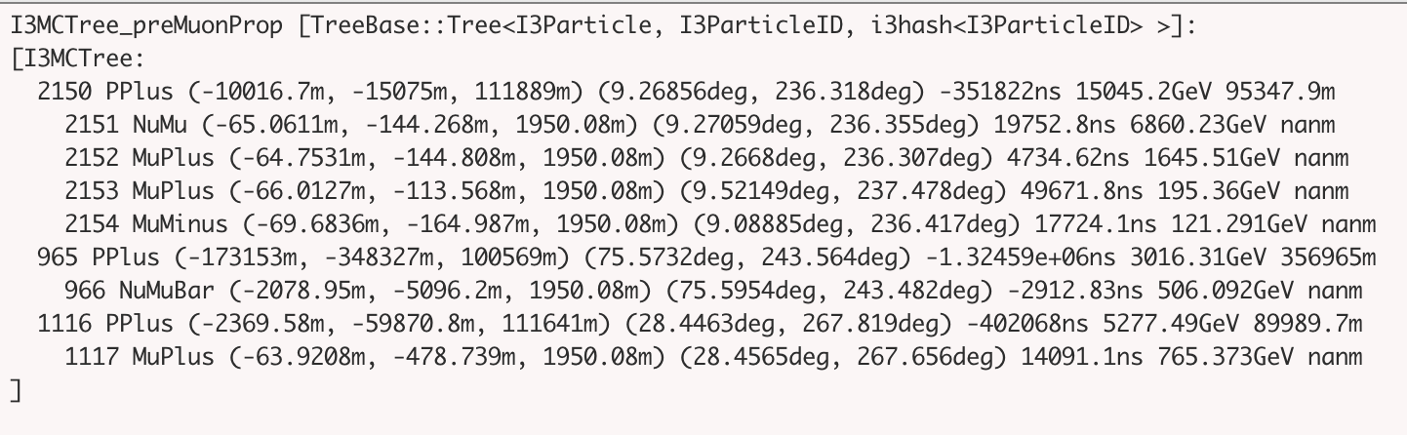
I3MCTree
Signal
Background

Slide 4
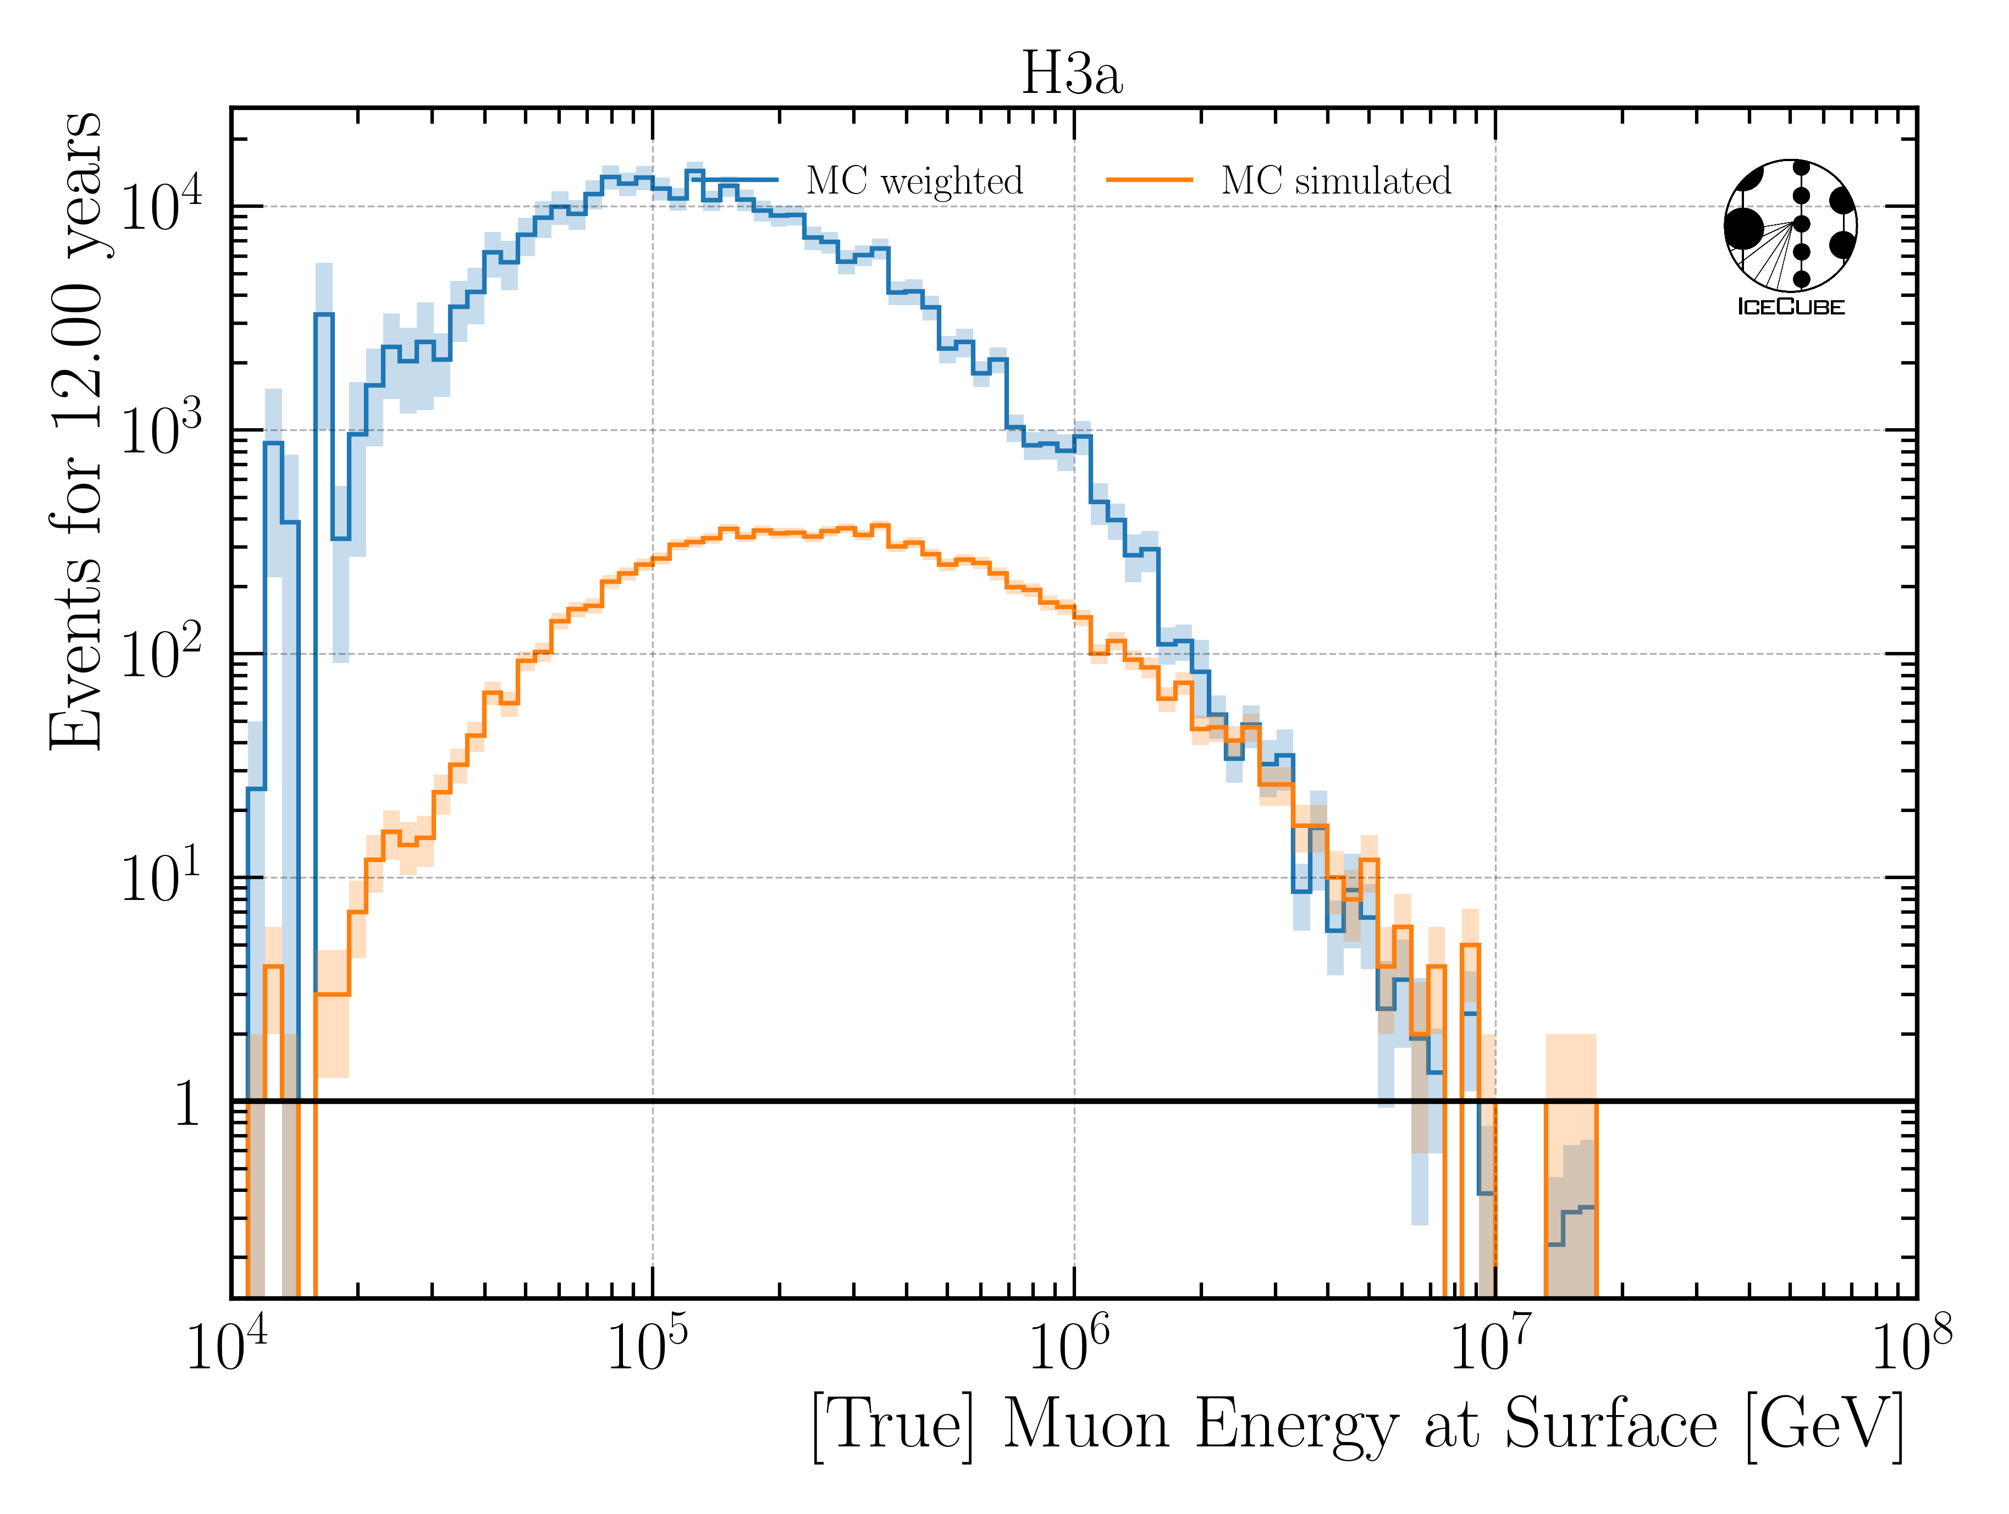
Check Signal Statistics for Muon Energy at Surface

Slide 5
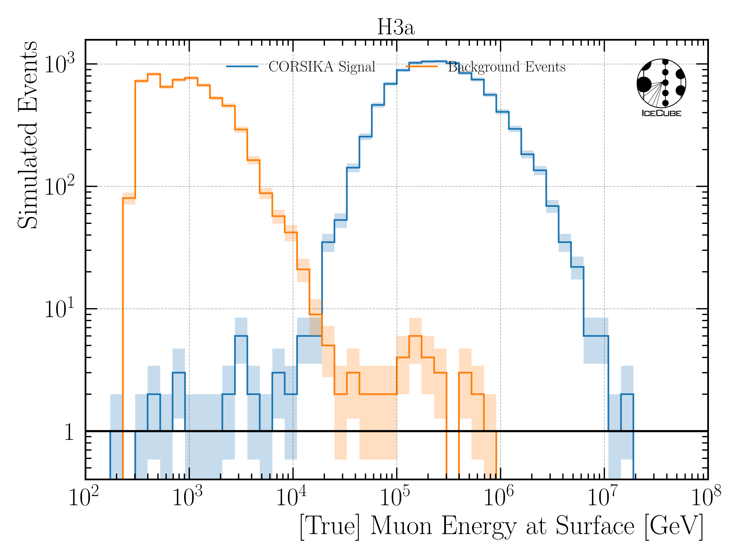
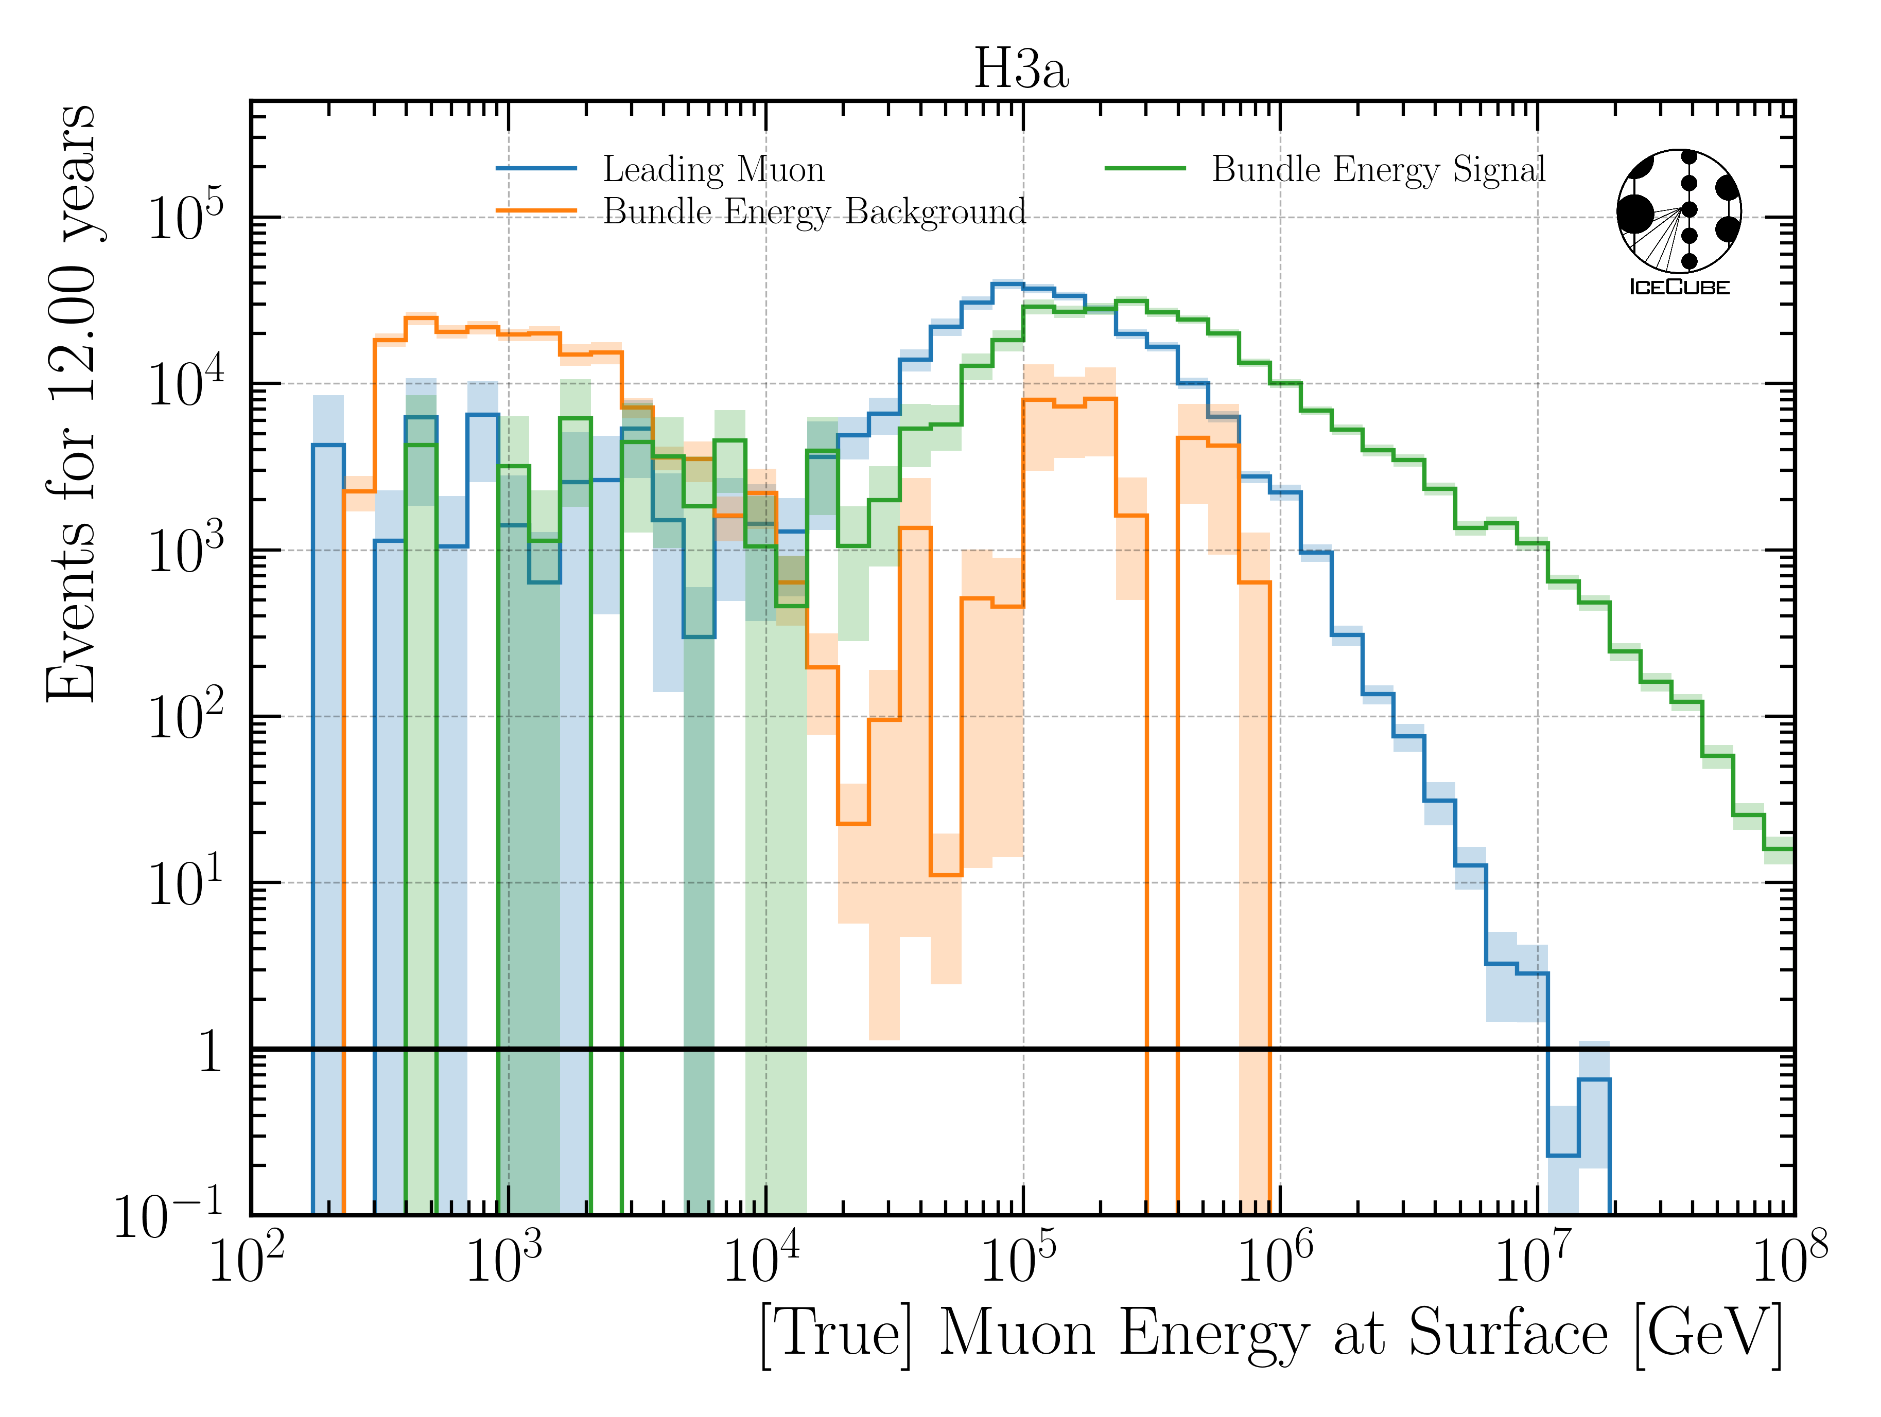
Muon Energy at Surface
simulated
weighted
Leading Muon: most energetic muon in tree
Bundle Energy Signal: sum of all muons of ”signal” primary
Bundle Energy Background: sum of all muons of coincident primaries

Slide 6
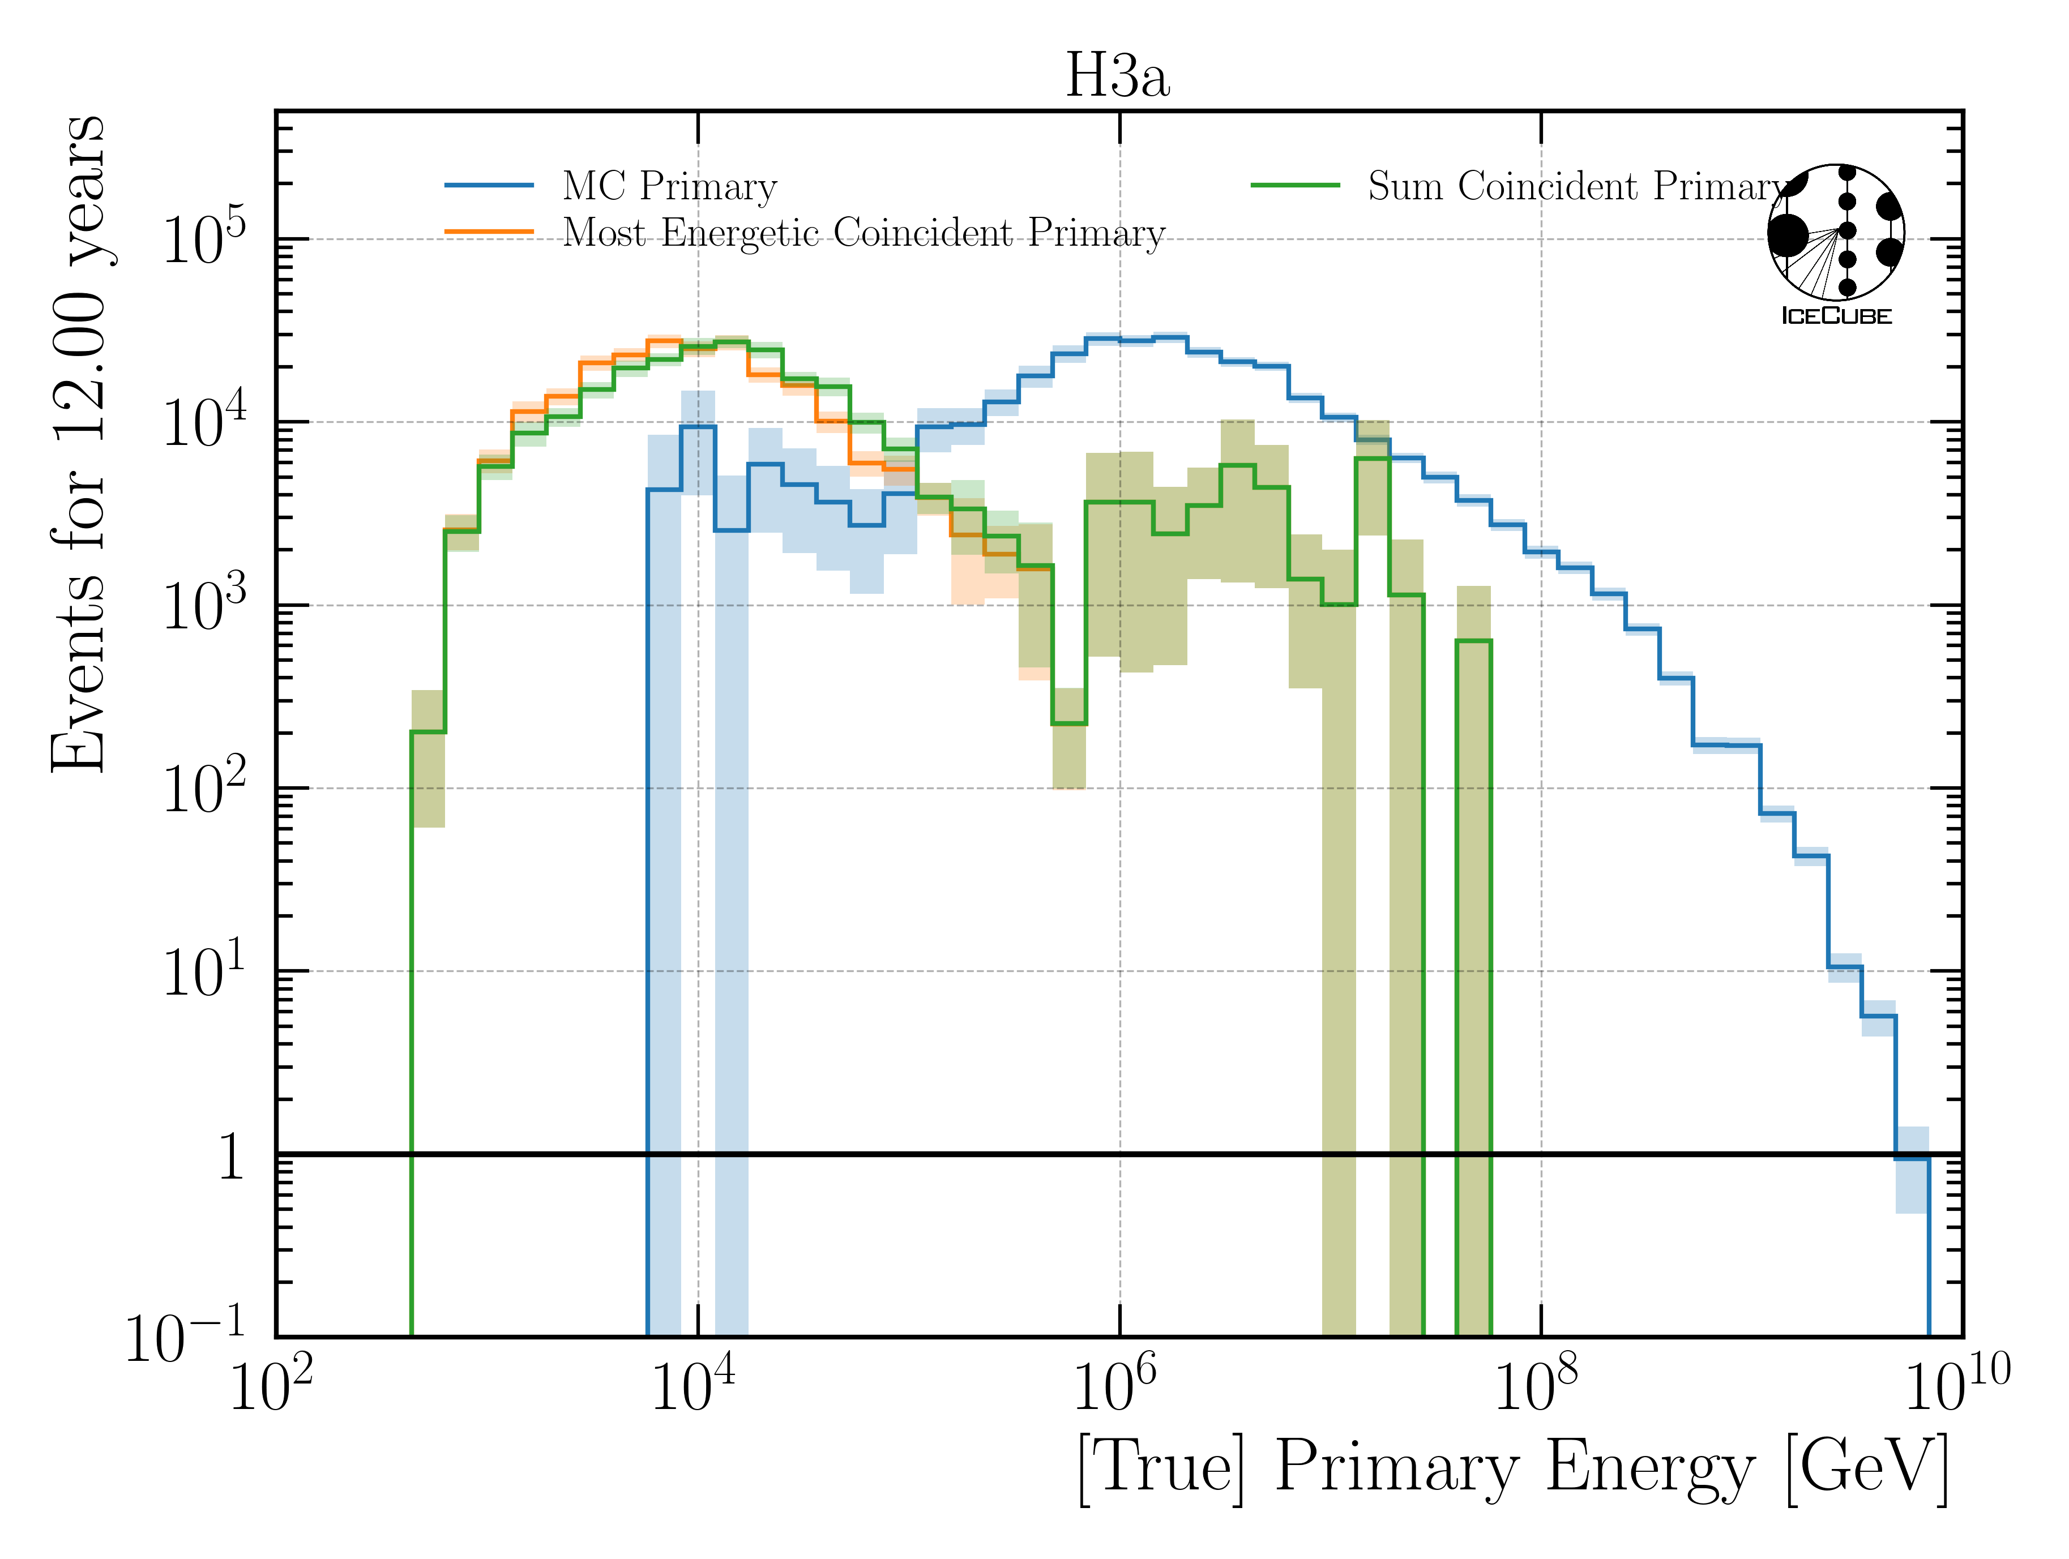
Primary Particles

Slide 7
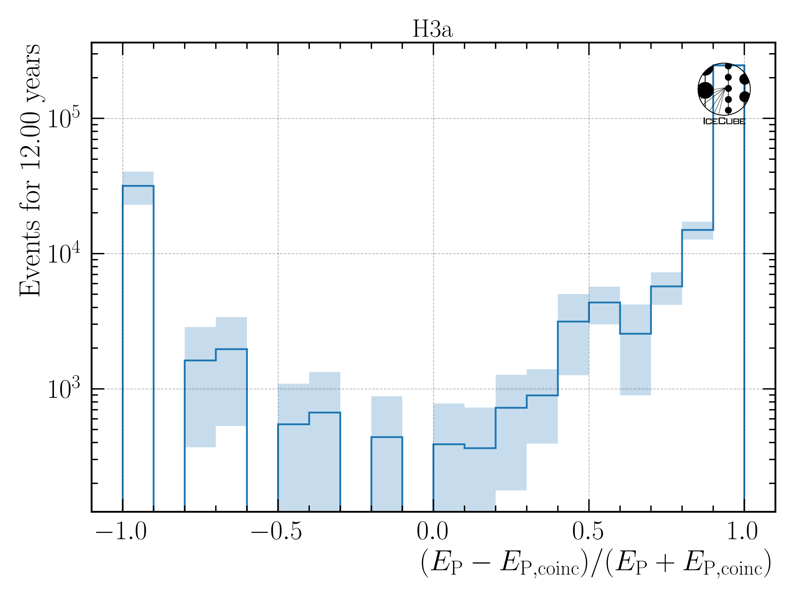
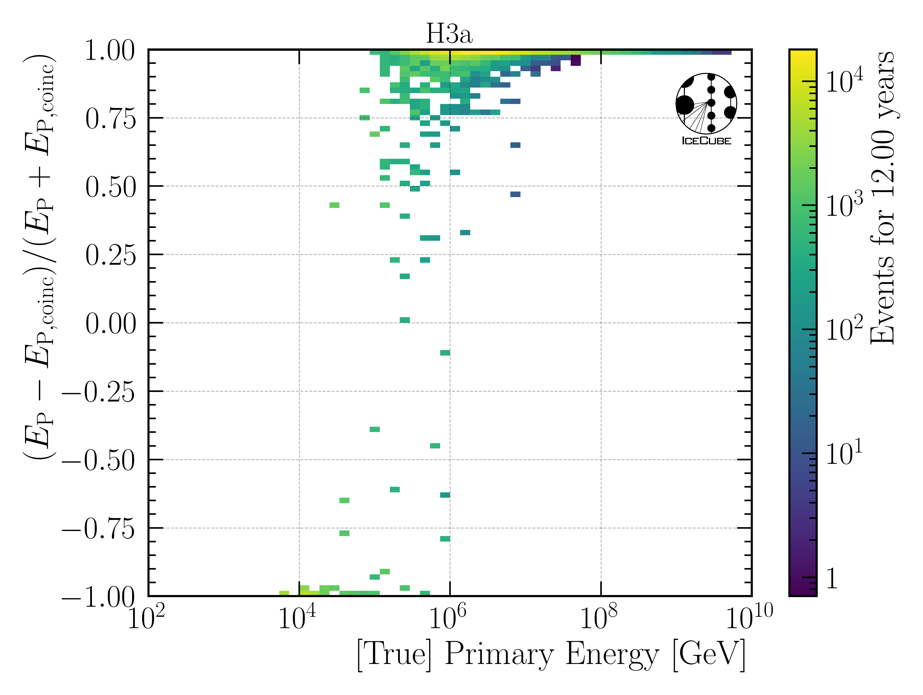
Primary Particles on Event Level
100% Signal Primary
50% Signal, 50% Background
100% Background Primary

Slide 8
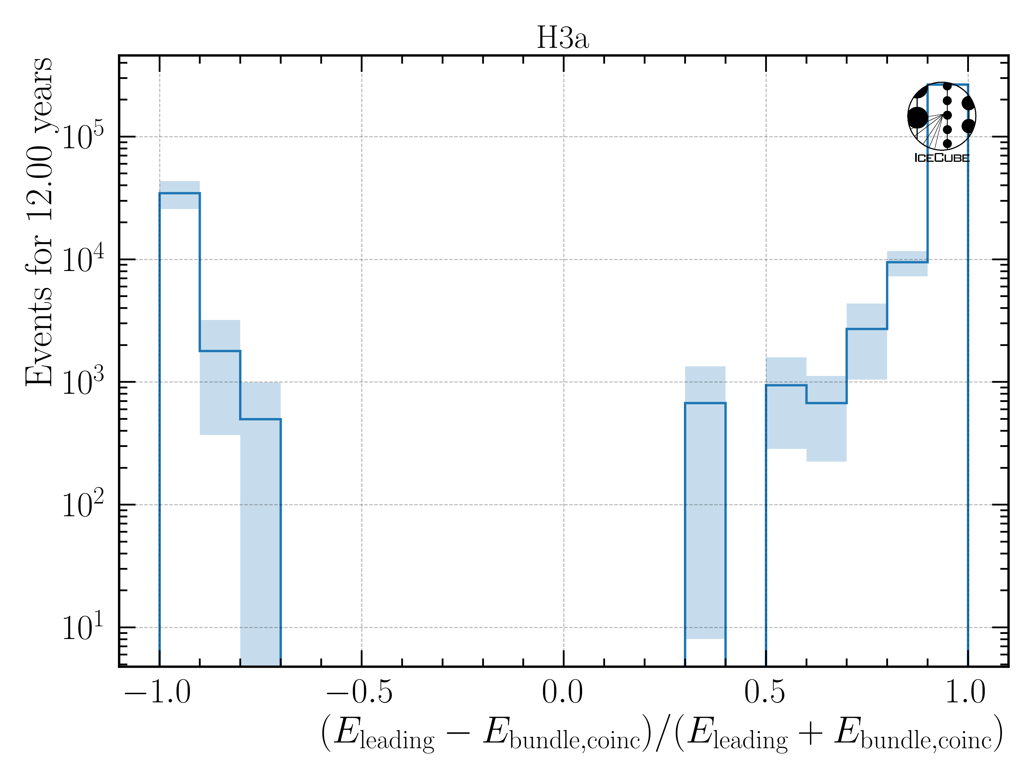
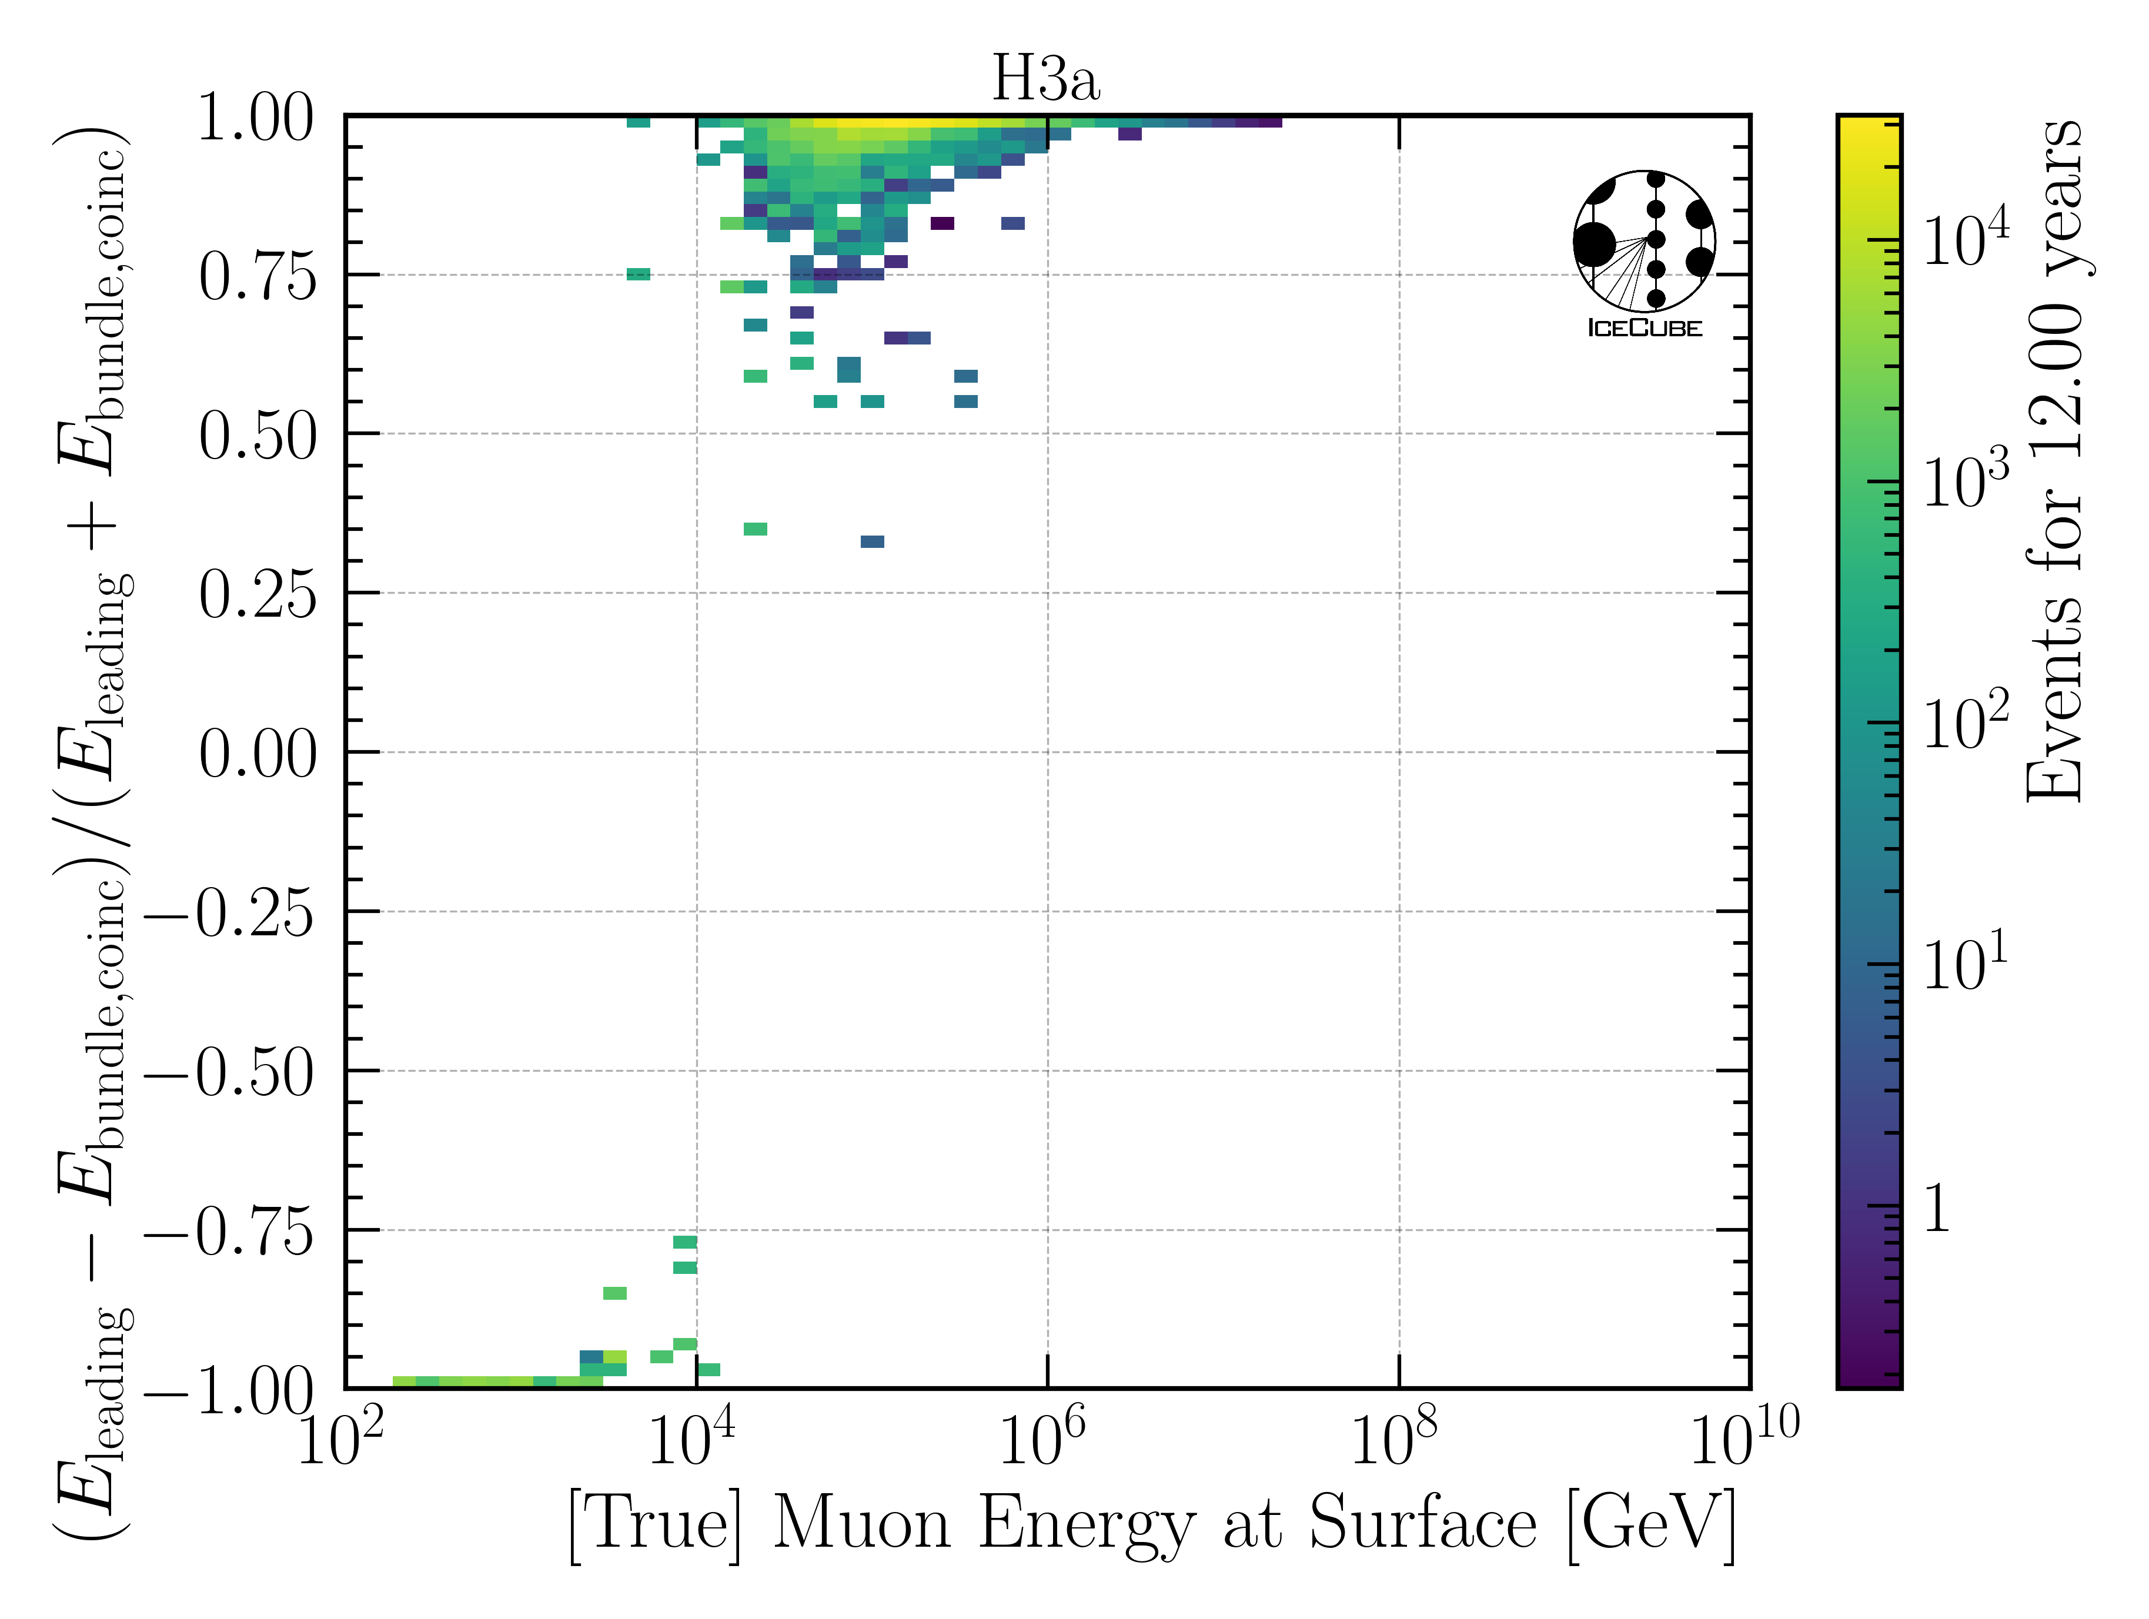
Muons on Event Level
100% Signal Primary
50% Signal, 50% Background
100% Background Primary
above 10 TeV, no background dominated events

Slide 9
Estimate Rates with H3a
Signal rate: 0.84 mHz (total event rate)
Background rate: 0.68 mHz (event rate with at least 1 coincident primary)
Signal rate: 0.74 mHz (leading muon energy at surface > 10 TeV)
Background rate: 0.58 mHz (event rate with at least 1 coincident primary & lead. muon E. > 10 TeV)
Signal rate: 0.74 mHz (leading muon energy at surface > 10 TeV)
Background rate: 0.02 mHz (event rate with at least 1 coincident primary & lead. muon E. > 10 TeV & coincident muon bundle energy at surface hast at least 10% of leading muon energy)
The light of the background events overlaps with the signal → no chance to separate
A 10% bundle energy contribution would shift the measured light up by roughly 10% → within the uncertainties of the energy prediction
Networks have been trained on MC with coincident events → they are able to subtract a little light in case they assume there is a background event, however, this is not quantified

Slide 10
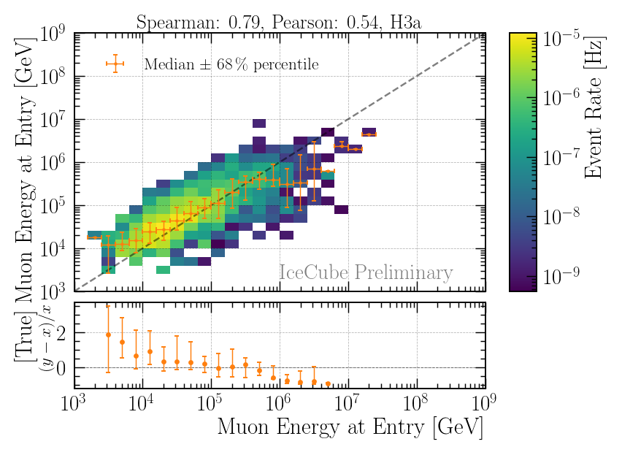
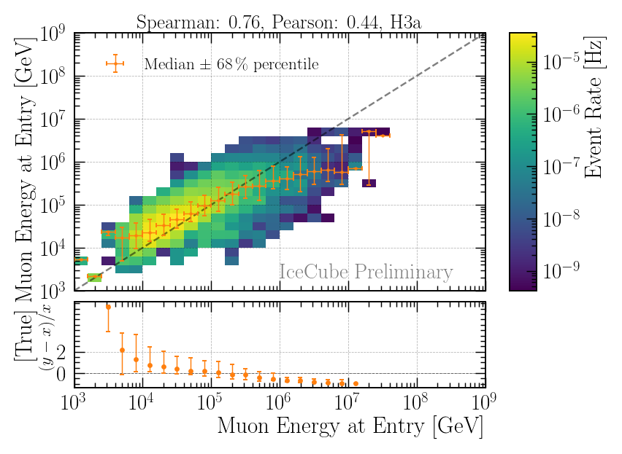
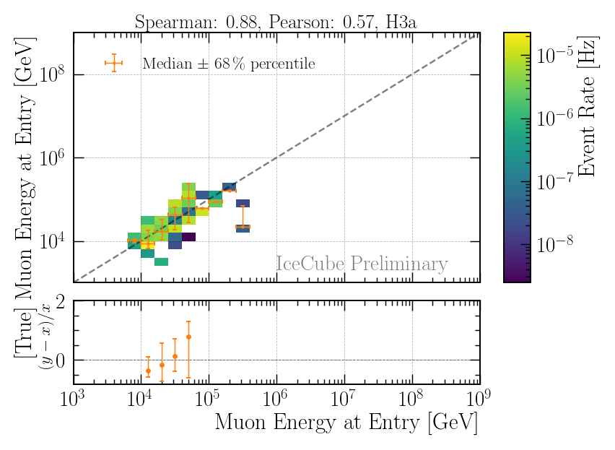
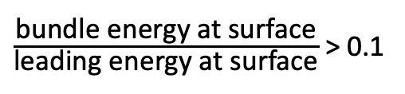
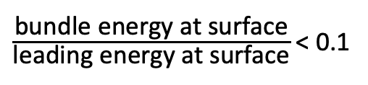
Reconstructions
no background event
$\frac{\text{bundle} \text{energy} \text{at} \text{surface}}{\text{leading} \text{energy} \text{at} \text{surface}}$ < 0.1
$\frac{\text{bundle} \text{energy} \text{at} \text{surface}}{\text{leading} \text{energy} \text{at} \text{surface}}$ > 0.1
sufficient energy reconstruction for events with background

Slide 11
Systematic Uncertainties

Slide 12
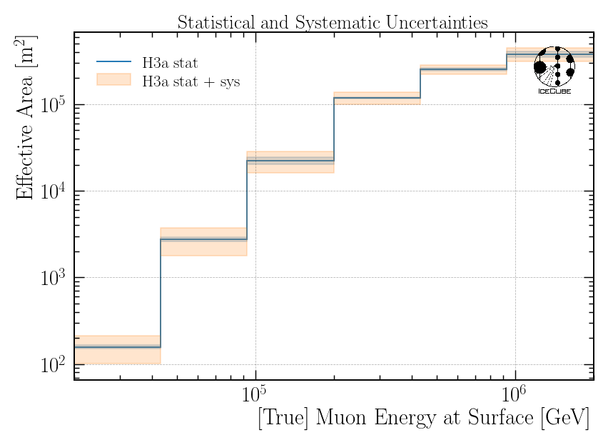
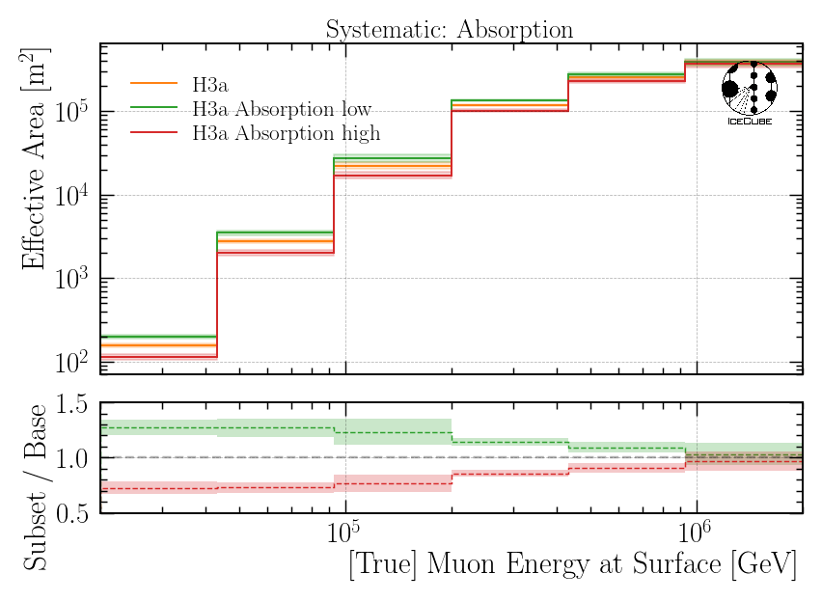
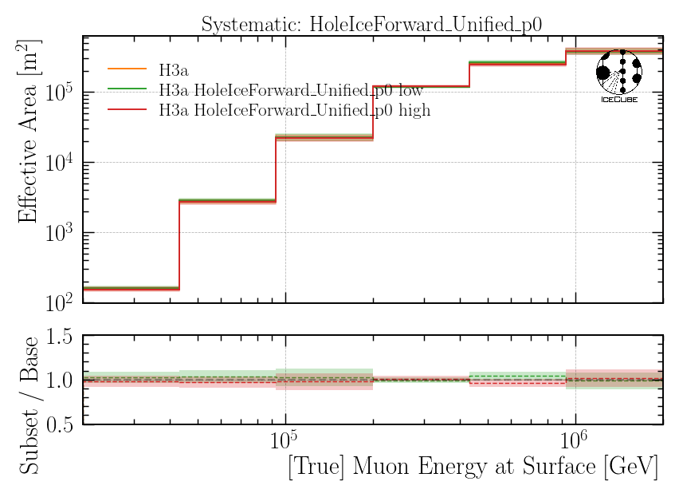
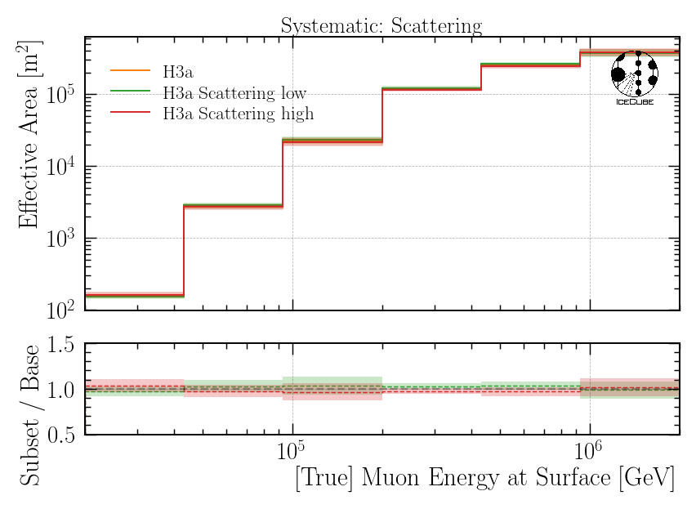
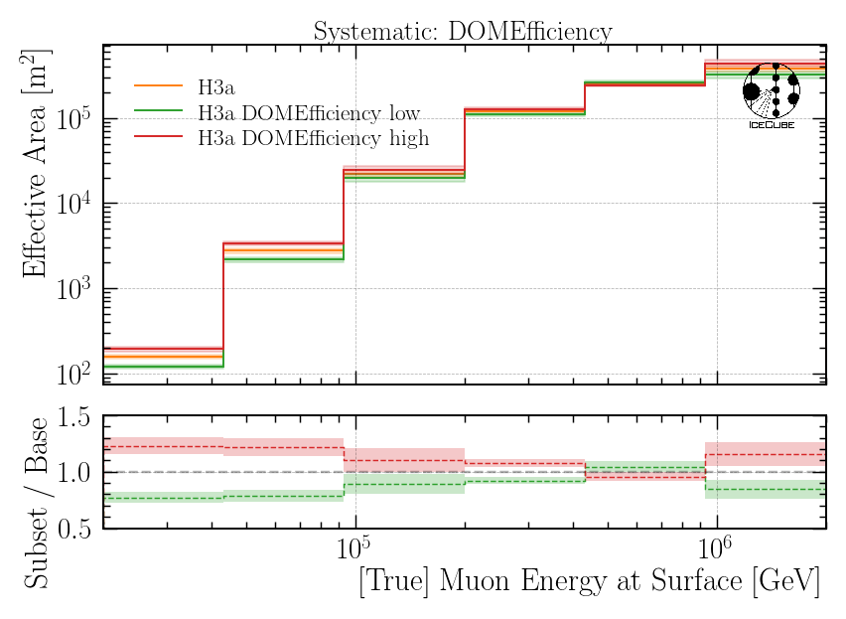
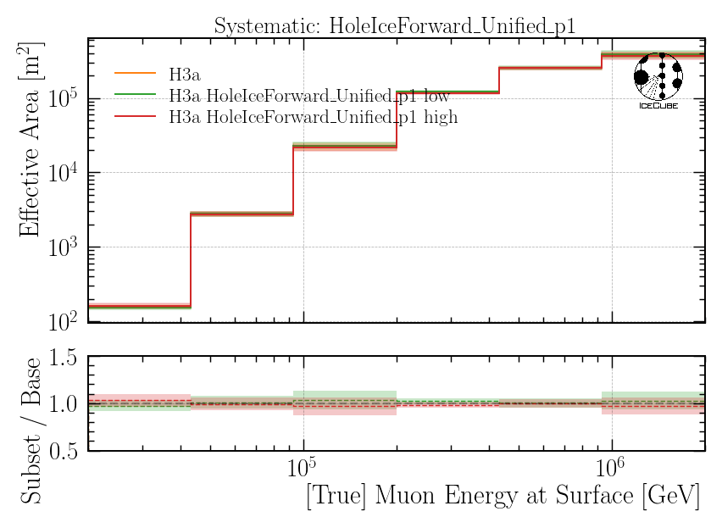
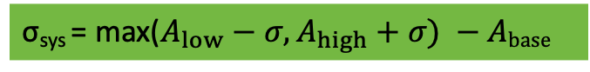
Effective Area → Systematics
Baseline: entire set
Subset: above/below center
σ_{sys} = max($A_{low}−σ, A_{high}+σ) −Abase$

Slide 13
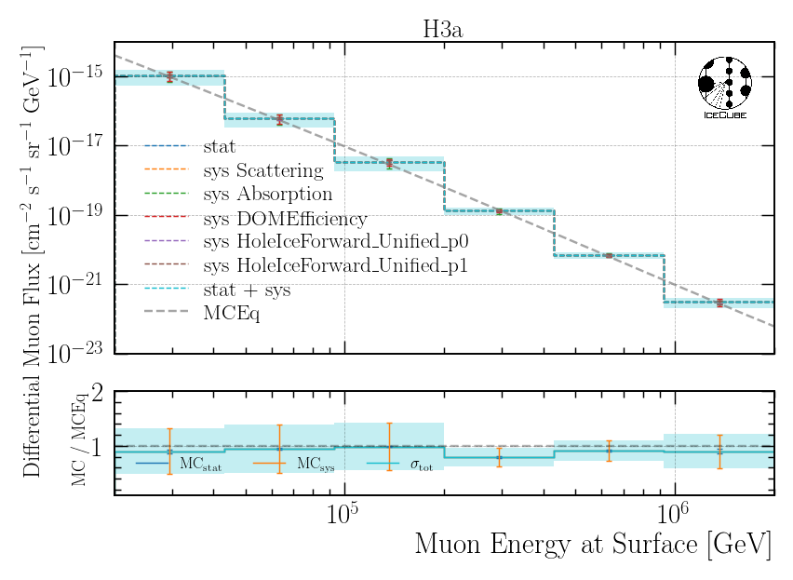
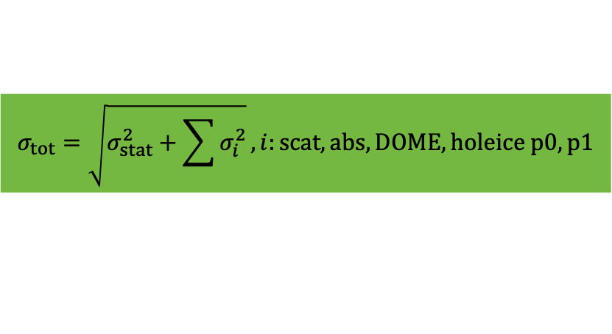
Effective Area with Systematics
Systematics: above/below center
Statistical: sum(weights**2)
$$σ_{tot}=\sqrt{σ_{stat}^{2}+\sum{σ_{i}^{2}}}, i:scat, abs, DOME, holeice p0, p1$$
“blind” uncertainty estimation by up- and down-scaling of the simulated systematics
provides a conservative uncertainty estimation
systematics are included in the fit → further knowledge available → shrinks the uncertainty

Slide 14
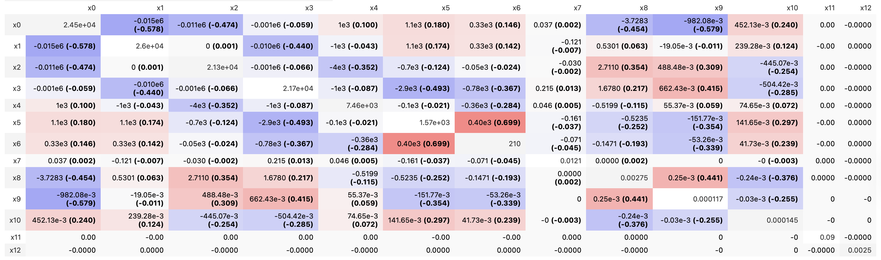
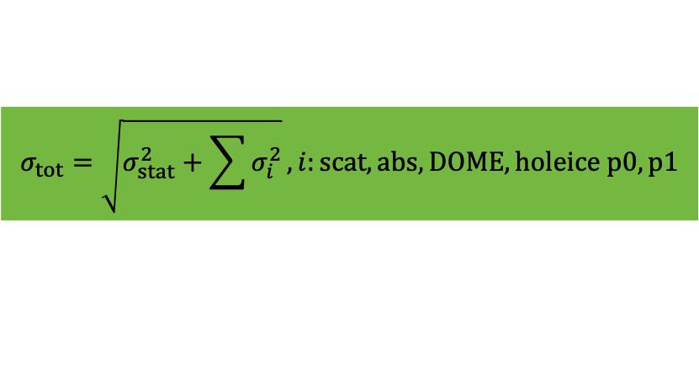
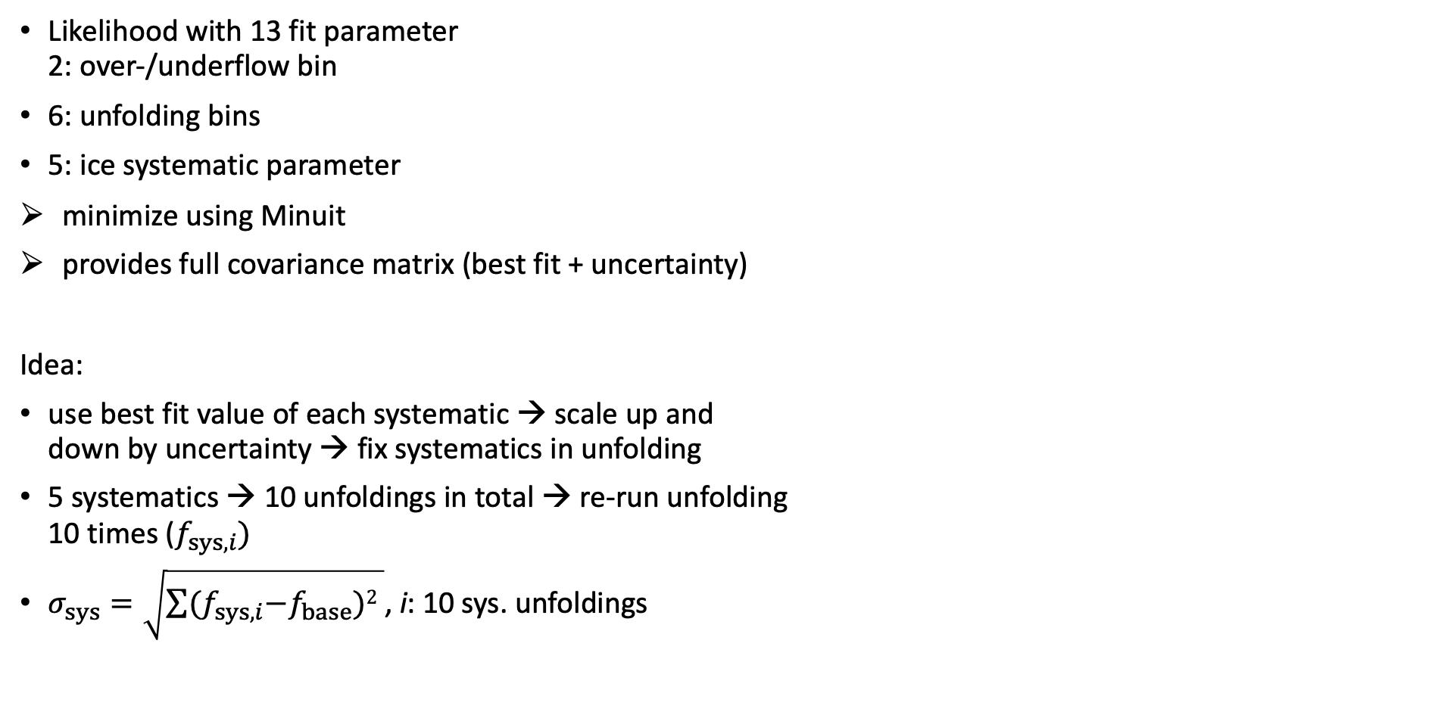
Unfolding: LLH minimization
Likelihood with 13 fit parameter 2: over-/underflow bin
6: unfolding bins
5: ice systematic parameter
minimize using Minuit
provides full covariance matrix (best fit + uncertainty)
Idea:
use best fit value of each systematic → scale up and down by uncertainty → fix systematics in unfolding
5 systematics → 10 unfoldings in total → re-run unfolding 10 times ($f_{sys, i})$
$σ_{sys}=\sqrt{\sum{{(f}_{sys, i}−f_{base})2 }}$, i: 10 sys. unfoldings
$$σ_{tot}=\sqrt{σ_{stat}^{2}+\sum{σ_{i}^{2}}}, i:scat, abs, DOME, holeice p0, p1$$

Slide 15
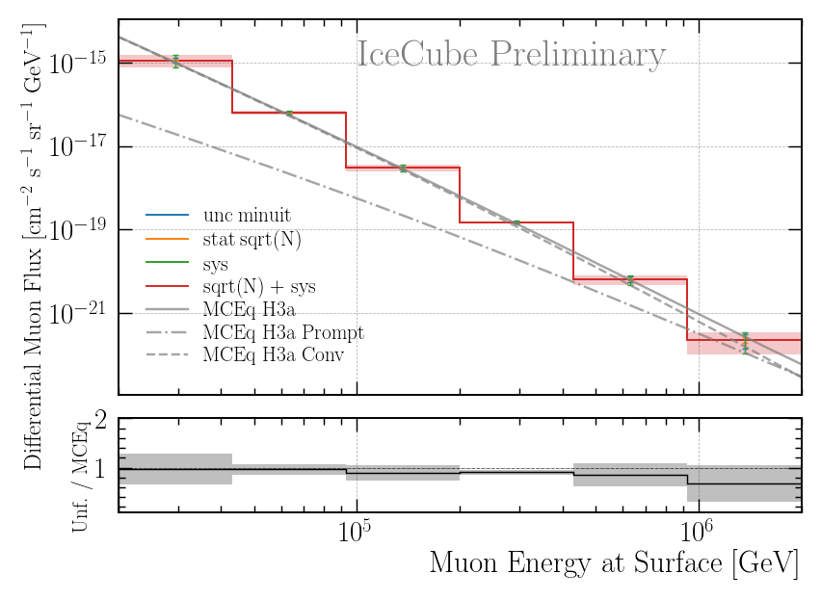
Test Method on MC
run unfolding on MC
re-run 10 times
fix all systematics in fit
take center value of simulation range → scale one systematic parameter up/down by 50% of the simulation range
Systematics: center ± 50% simulation range
Statistical: sqrt(N)

Slide 16
”Round trip”
Systematics: above/below center
Statistical: sum(weights**2)
Systematics: center ± 50% simulation range
Statistical: sqrt(N)
both methods provide similar uncertainties
it is NOT expected that the uncertainties are the same (left method also includes limited MC statistics from the weights)

Slide 17
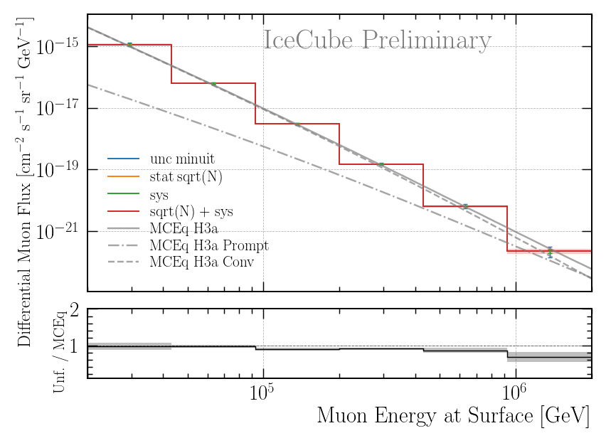
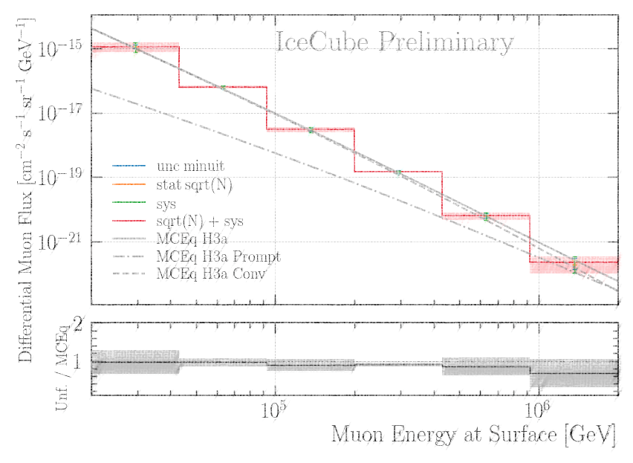
Burnsample MC
Systematics: best fit ± sigma
Statistical: sqrt(N)
Systematics: center ± 50% simulation range
Statistical: sqrt(N)

Slide 18
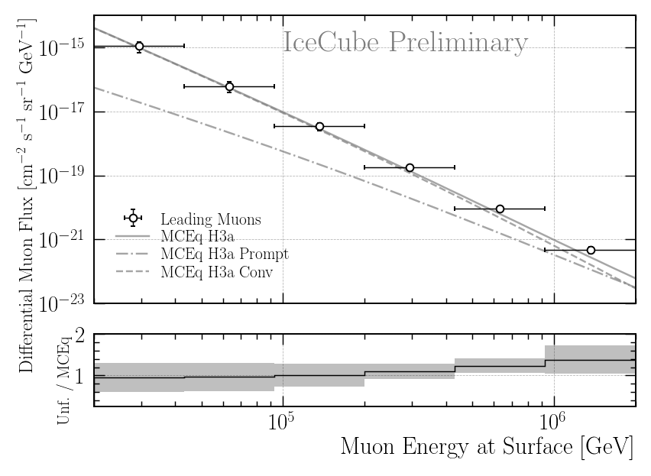
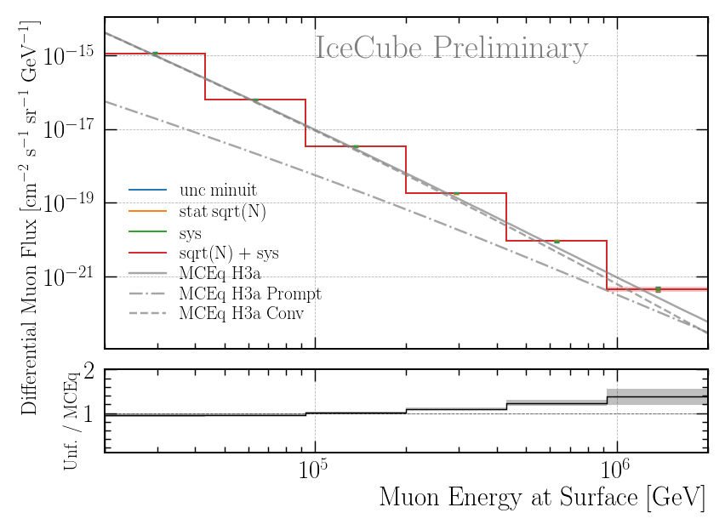
Burnsample Data
Systematics: ± 50% on MC effective area
Statistical: minuit uncertainty
Systematics: best fit ± sigma
Statistical: sqrt(N)
new uncertainty
estimation
ICRC plot

Slide 19
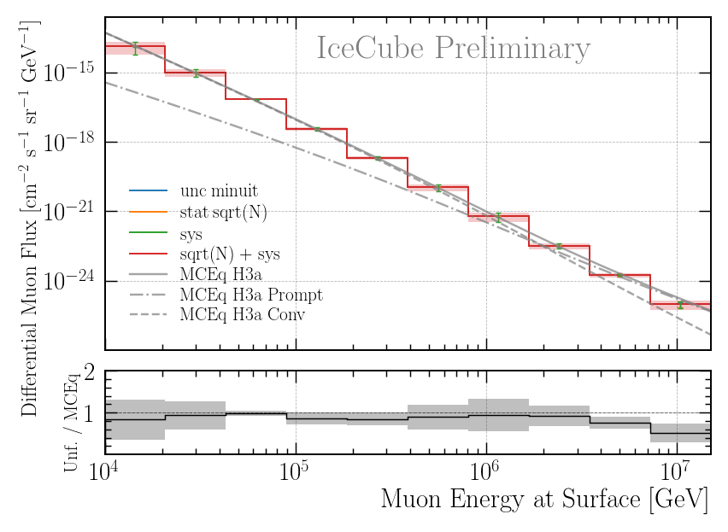
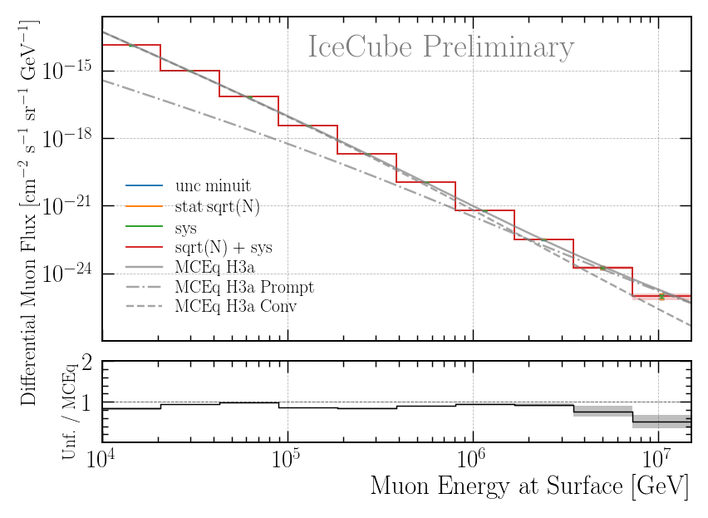
Full Statistics MC
Systematics: center ± 50% simulation range
Statistical: sqrt(N)
Systematics: best fit ± sigma
Statistical: sqrt(N)

Slide 20
Conclusion
Coincident primaries estimated → negligible towards higher energies
primarily low-energy contribution
Estimate systematic uncertainties via scaling of systematics and re-run unfolding
more precise uncertainty estimation
“tested” against up/down-scaling of effective area calculation
similar results (same results are not expected)
Questions?

Slide 21
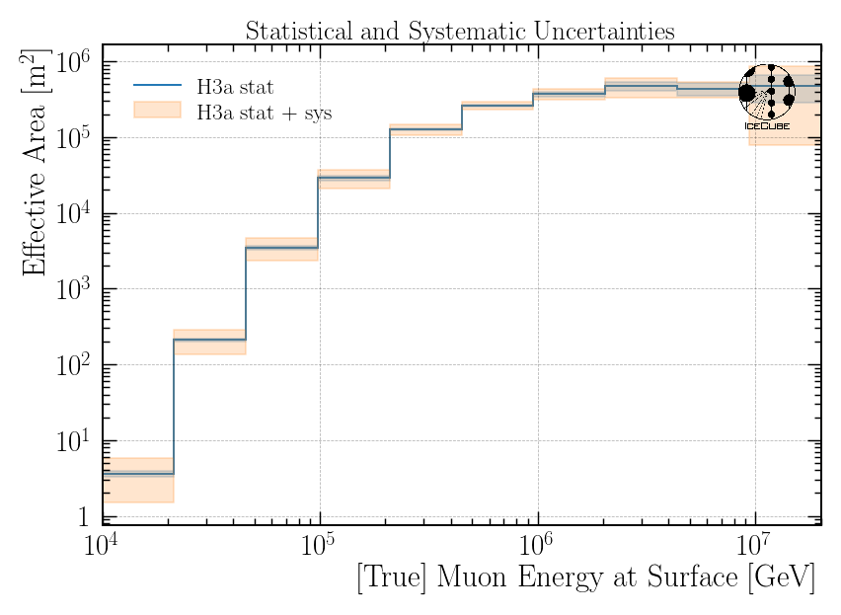
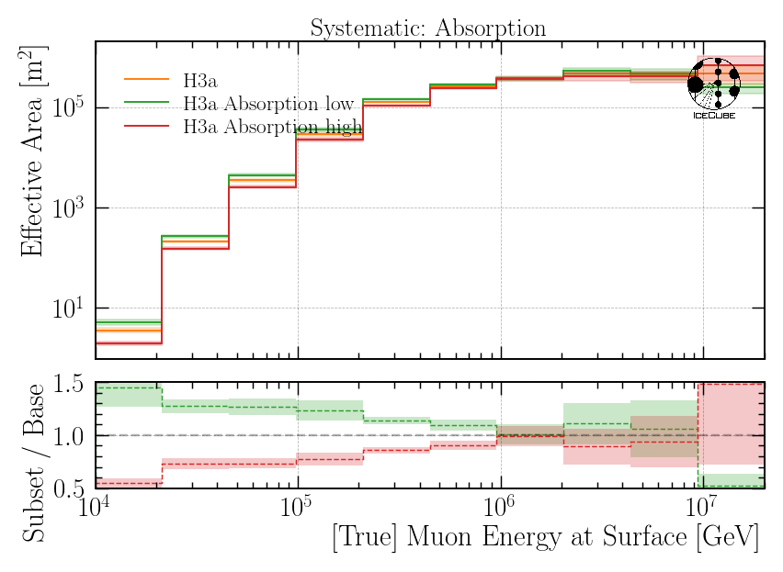
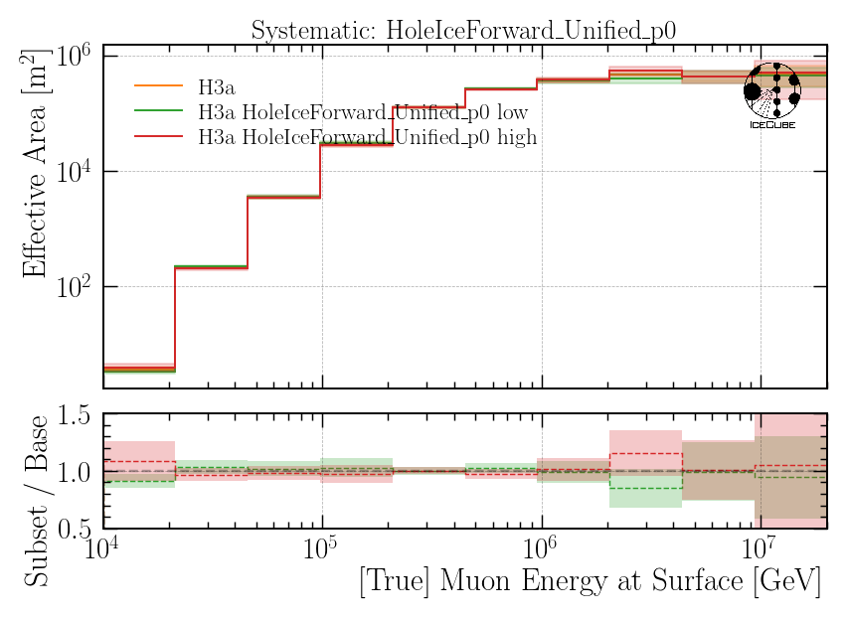
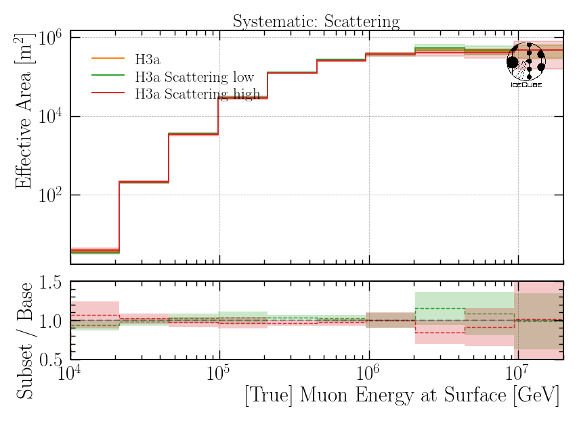
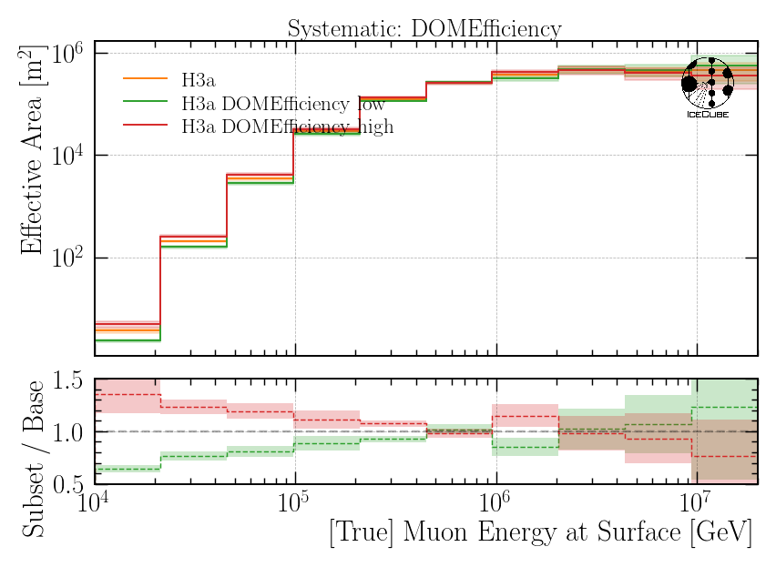
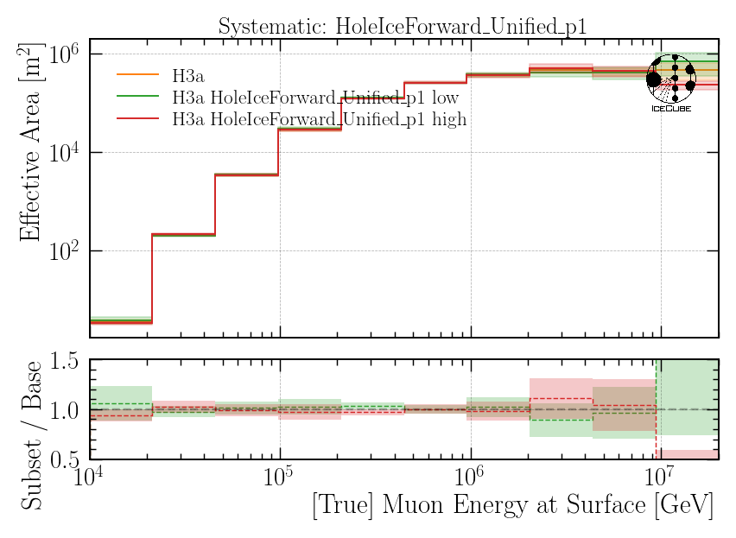
Effective Area Systematics

Slide 22
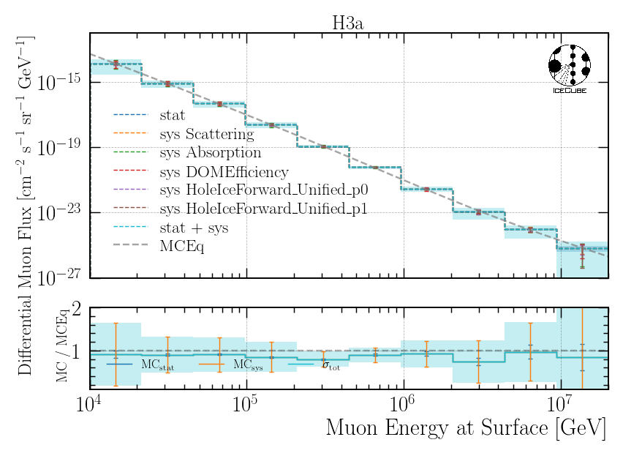
Full Statistics MC Systematics

Slide 23
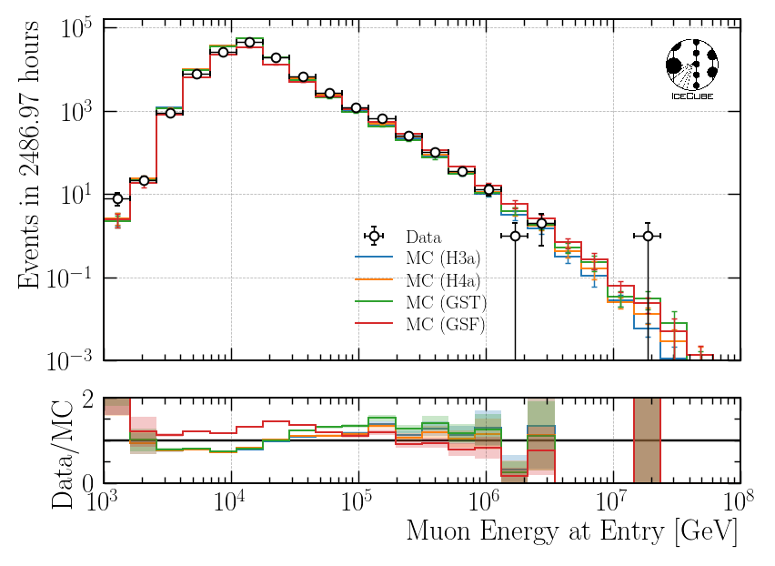
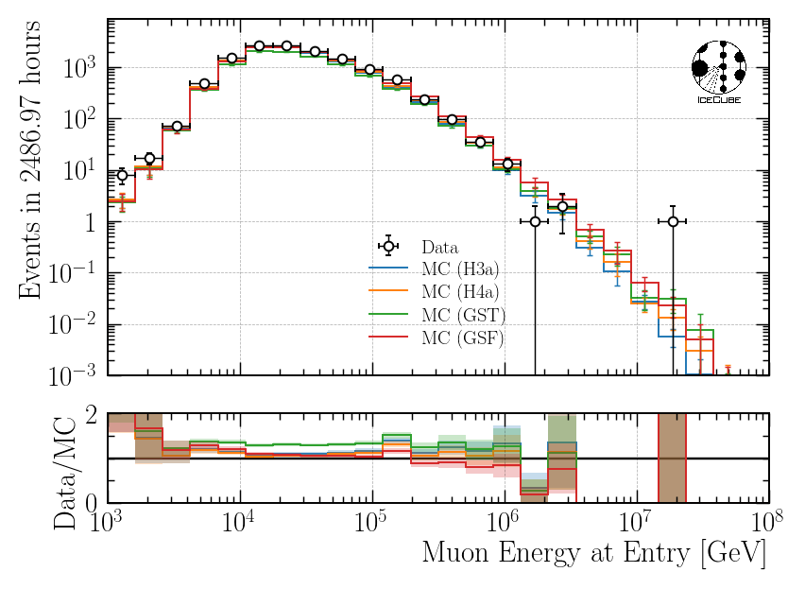
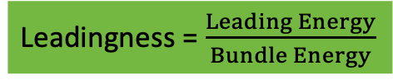
Data—MC Proxy Variable
Leadingness = $\frac{Leading Energy}{Bundle Energy}$
Leadingness > 40%

Slide 24
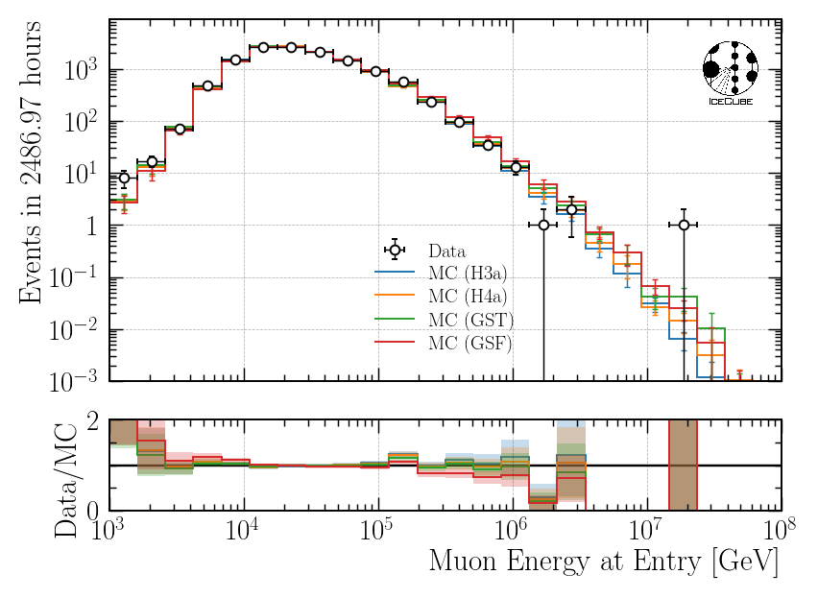
Data—MC Proxy Variable: Leadingness > 40 %
Nomalizations:
H3a: + 12 %
H4a: + 9%
GST: + 32%
GSF: + 9%
MC shapes agree with data
Total normalization has NO impact on unfolding

Slide 25
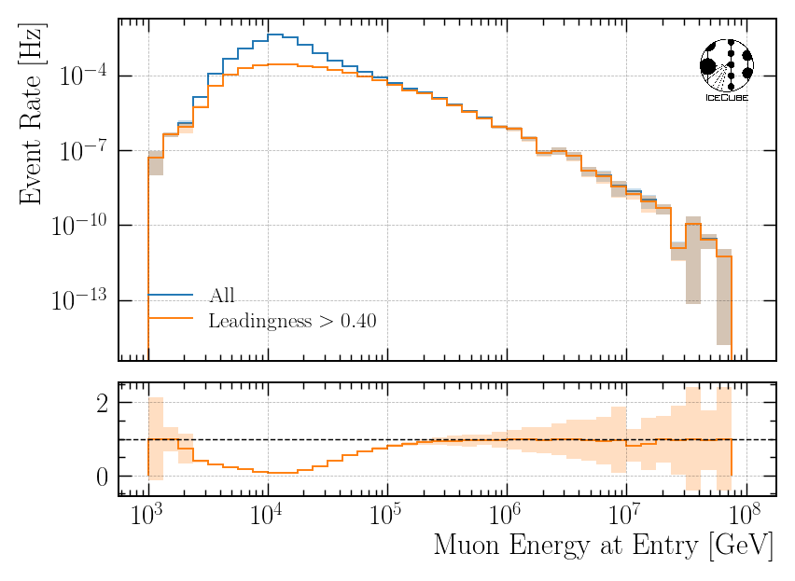

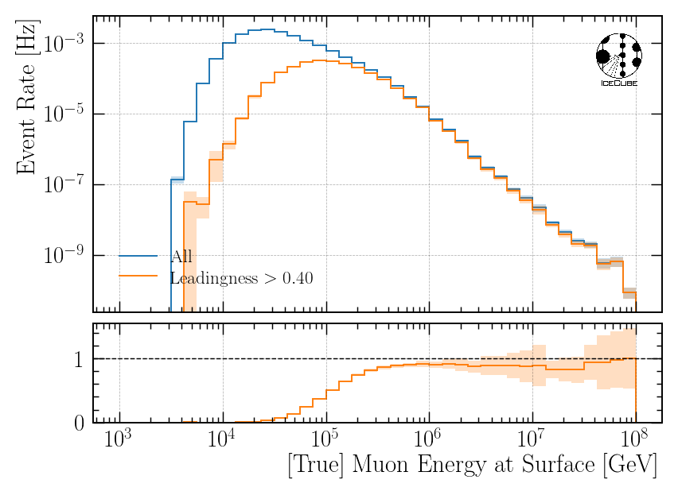
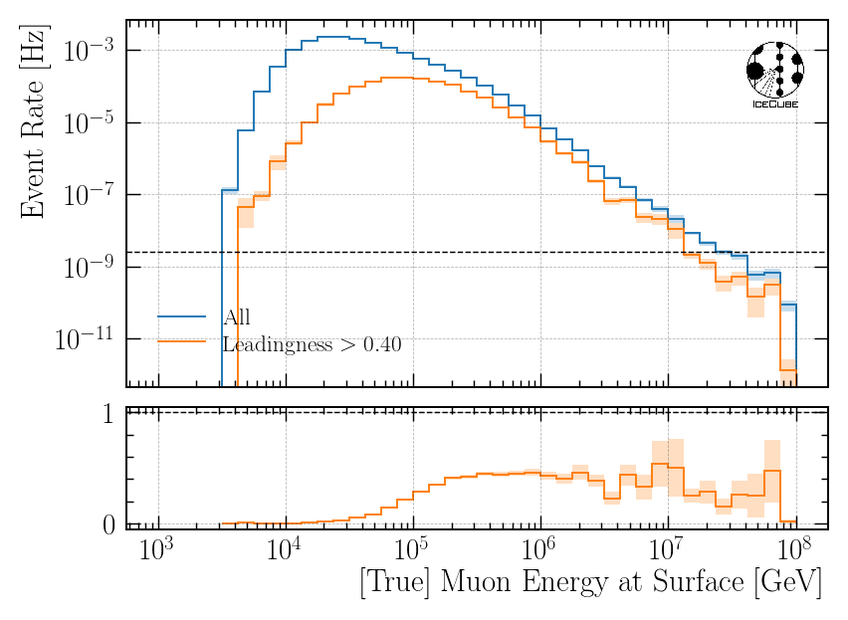
Proxy & Target Distributions Before/After cut (True & Reco)
Proxy
Proxy
Cut on TRUE leadingness
Cut on PRED leadingness
Target
Target

Slide 26
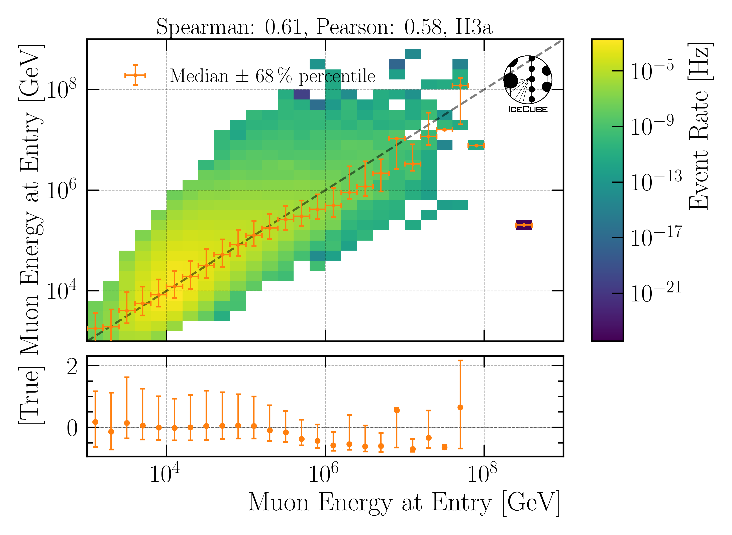
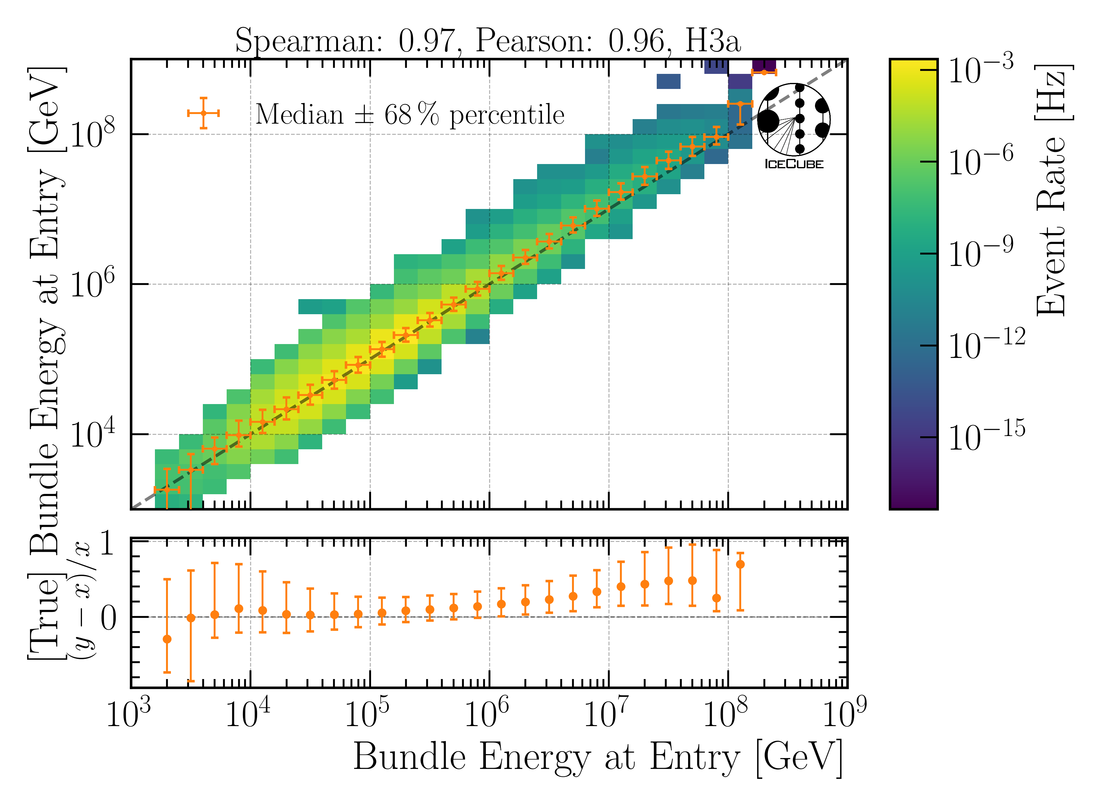
Reconstructions for Leadingness: Level 5

Slide 27
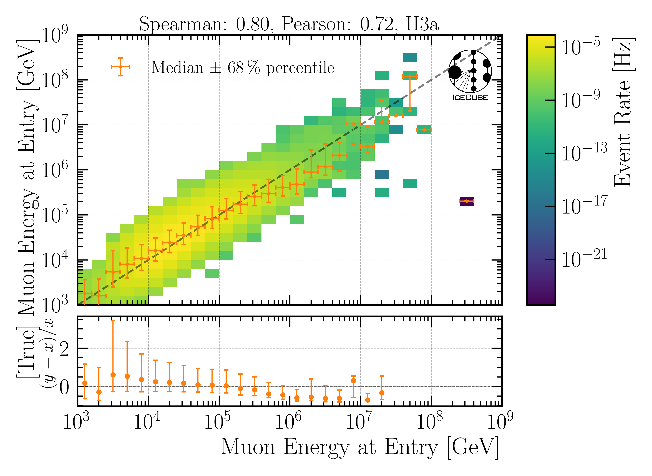

Reconstructions after Leadingness cut: Final Level
Improved reconstructions

Slide 28



Unfolding on 12.12 years MC Pseudo data
Find reguluraization with minimal correlation: (V: Covariance Matrix)

Slide 29


Robustness Tests
Build unfolding matrix on H3a, H4a, GST and GSF
Unfold H3a as “test data”
Build unfolding matrix on H3a with 𝛾 ± 0.1
Unfold H3a as “test data”

Slide 30

Test: Pseudo Data set includes ONLY conv
Expectation: Unfolding agrees with conventional
Works as expected
Ratio to conv
No effective area are uncertainties shown
Ratio to total

Slide 31

Test: Pseudo data includes prompt & conv
Expectation: Unfolding agrees with total
Works as expected
Ratio to conv
No effective area are uncertainties shown
Ratio to total

Slide 32
Conclusion
Leadingness > 40 % improves data—MC of proxy variable
Additional cut → Final Level
Better reconstructions
Better correlation
Unfolding works on MC for 12.12 years of data
Robustness for different primary mass compositions and 𝛾 ± 0.1 presented
Algorithm is sensitive to prompt
When injecting conv only → conv is revovered
When injecting conv and prompt → total is recovered

Slide 33
Binning – info for myself
Plots in these slides have been created with the proxy resolution binning k = 1
Proxy: bins = np.geomspace(1.5e3, 1.5e7, 11)
Unf: unf_bins = np.geomspace(1e4, 1.5e7, 11)
Test set: H3a, seed 42

Slide 34


Final Level Statistics

Slide 35


Final Level Statistics: Proxy & Target Binning

Slide 36




Impact of Astrophysical Neutrinos – Muon Energy at Entry
$$n=1.5, γ=2.6$$
NuGen: only astro
NuGen: atmospheric and astro
Neutrinos contribute ~10% to total flux at high energies > 5 PeV

Slide 37


Assume Latest Astrophysical Diffuse Results by IceCube
ArXiv: 2308.00191
Test SPL and BPL

Slide 38



Impact of Astrophysical Neutrinos – Muon Energy at Entry
$$n=1.8, γ=2.52$$
2308.00191
NuGen: only astro
NuGen: atmospheric and astro
Neutrinos contribute ~10% to total flux at high energies > 5 PeV

Slide 39

Cos(zenith) Distribution
Expect more neutrinos from the horizon
Apply stronger zenith cut to remove neutrinos
horizontal
vertical

Slide 40



Impact of Astrophysical Neutrinos – Muon Energy at Surface/Entry
NuGen: atmospheric and astro
NuGen: atmospheric and astro
$$n=1.77, γ1=1.31,γ2=2.74$$
$$log10(Ebreak)=4.39,$$
For BPL: Neutrinos contribute less than 10%
2308.00191

Slide 41
Z—Vertex Data-MC
Networks were trained on several old CORSIKA simulation datasets to make them robust
Re-train on new ice model spice_ftp-v3m

Slide 42


Z—Vertex Data-MC: Entry Position
Old ice model
New ice model

Slide 43


Z—Vertex Data-MC: Center Position
Old ice model
New ice model

Slide 44


Cos(zenith)
Old ice model
New ice model
Artefacts observed in zenith reconstruction
Re-train zenith reco network

Slide 45
Include Systematic Uncertainties on Effective Area

Slide 46






Effective Area
Baseline: entire set
Subset: above/below median

Slide 47

MCEq vs CORSIKA
Uncertainties on Flux
CORSIKA stat.
Eff. area stat.
Eff. area sys.
Eff. area stat. on sys. subset
Good agreement between MCEq & CORSIKA
𝛘²– Test (H3a):
p—value: 0.683

Slide 48
Unfold Burnsample

Slide 49


Unfold Burnsample
MC
Burnsample
𝛘²– Test (H3a) Conv only:
p—value: 0.587
Unfolding works on MC & burnsample

Slide 50

Stopping Muons and Leading Muons
Work in progress
Use stopping muons to unfold low energy muon spectrum
Use leading muons to unfold high energy muon spectrum
Atmospheric muon flux unfolding is promising

Slide 51
Conclusion & Outlook
Neutrino background investigated
BPL smaller impact than SPL
Include uncertainties on effective area
statistics & systematics
Agreement between MCEq & CORSIKA
Unfolded burnsample up to 2 PeV
Re-trained DNNs on new ice models
z—vertex Data-MC improved
Outlook
Unfold for different neutrino background assumptions
Evaluate new reconstructions in detail
Unfold on selection with new networks
Unfold on 12.12 years of data
Burnsample
Thank you for your attention!

Slide 52

Burnsample Proxy

Slide 53


Statistics
Proxy
Target

Slide 54


Q: Why do you choose the muon filter?
HighQFilter: removes more horizontal events → muons travel large distances, not enough energy left to pass high-charge filter
Goal: keep AMAP high-energy events at surface → muon filter

Slide 55



Q: Which quantities do you reconstruct and how do you do this?
10.1088/1748-0221/16/07/P07041
Energy
Bundle energy at entry / surface
Leading muon energy at entry / surface
Direction
Zenith / azimuth of leading muon
Geometry
Propagation length
Entry point
dnn_reco framework (Mirco Hünnefeld)
Low-level features based on charge and timer per DOM

Slide 56

Q: Coincident events are not simulated. Can you show that this does not cause any problems?
For primary energies above 10 TeV, using a time window of 6 µs, the chance for a coincident event is ≤ 1 %
Apply time-window cleaning of 6 µs to pulses
Linear scale
Log scale

Slide 57


Q: What is the impact of the primary flux on your (most important) distributions?
Primary models diverge towards higher energies

